Slide 1
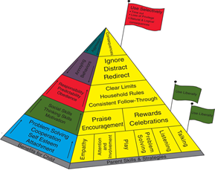
South Derbyshire and South Dales LCP
Notes:
Introduce self

Slide 2
Targeted Family Support
Identification of need
Funding
Engaging Partners
Notes:
Key themes were decided by South Derbyshire and South Dales LCP members approximately 2 years and one of those was family support with an emphasis on improving parenting skills. LCP members used the toolkit for identifying locality need which showed at the time out of 1096 referrals made to service, 400 of these were for parenting support (36%). This evidenced an area of need for support in developing positive parenting skills that could be met more efficiently in a group delivery model (as outlined in NICE guidelines) than on a 1:1 basis.
There had been a successful delivery of the evidence based Incredible Years programme within the South Derbyshire and South Dales locality for both the 2-8 and 8-13 year old programmes. This led to the then working group lead to secure funding through Public Health to provide multi-agency training.
The offer was made to members of the LCP to attend the training and this was attended by Homestart, Schools, the Police and DCC Staff members.

Slide 3
Partnership Working
Working with Partners in the local Primary schools we increased capacity to deliver Incredible Years.
Current Examples include:
The Elms Centre
Fairmeadows School
Woodville Youth Centre
Completed Programmes:
Woodville Children’s Centre
Hilton School
Notes:
Partners attending the training has increased the capacity for programmes being run in the area, some of which have been co delivered between MAT and School staff. For example:
In the Etwall area the assistant head, pastoral lead and School nurse attended the training and after co- delivering with MAT staff (facilitators are required to deliver the first programme with an experienced facilitator) are now delivering the Incredible Years themselves within the setting.
Current examples of partnership working with LCP members:
The Elms centre is co facilitated by Tina Arckless from Elmsleigh School and MAT staff member. This is a 2-8 programme.
Fairmeadows School is again delivered with colleagues from Fairmeadows school. This is also a 2-8 programme.
Woodville Youth Centre is an 8 -13 year programme delivered by two MAT staff members.
All of which were over subscribed and necessitated a waiting list.
Completed Programmes:
Woodville children’s centre completed on 24th April and was co delivered with staff from Woodville School.
Hilton Primary have delivered 2 programmes and have had a waiting list on both occasions.
Partner feedback – Schools have shared that running the programmes have meant they are able to offer support to families before there is an escalation of need and referral into service having the potential to reduce the referral rate for Children’s Services.
We are awaiting the statistical outcomes of the recent programmes as some of these have only recently finished and others are still running. However previous courses show us reductions in the behaviours experienced by families and conversely improvements in parental mental wellbeing.
The approach taken by the LCP is a good example of a community empowerment model
The LCP provides a steer to tasking groups who have been able to build capacity within the community in the locality. The training has meant that we are able to target the vulnerable population in our area and work collaboratively with partners to increase the accessibility, appropriateness of service and responsiveness to the vulnerable population.

Slide 4
The Incredible years…
…is a 12-15 week programme aimed at helping parents to find different ways to manage their children’s challenging behaviour, from 2 year olds to teenagers
IT IS NOT:
A magic wand to solve all parent’s problems
Someone telling parents what to do
For ‘bad’ parents!
Incredible years is a chance to meet other parents and collaboratively to share and try new ideas in a friendly, confidential and supportive environment.
In the group we talk about:
Making the time they spend with their children enjoyable
Ways to encourage their child’s learning and development
Building their child’s confidence
Managing challenging behaviour
Managing their own emotions and stress
Notes:
What is the incredible years?
The Incredible Years is a 12-15 week programme aimed at helping parents to find different ways to manage their children’s challenging behaviour, from 2 year olds to teenagers
IT IS NOT:
A magic wand to solve all parent’s problems
Someone telling parents what to do
For ‘bad’ parents!
Incredible years is a chance to meet other parents and collaboratively to share and try new ideas in a friendly, confidential and supportive environment.
In the group we talk about:
Making the time they spend with their children enjoyable – special time
Ways to encourage their child’s learning and development – using coaching
Building their child’s confidence - using praise
Managing challenging behaviour – including using thoughts, feelings and behaviour cycle
Managing their own emotions and stress – self-talk

Slide 5
How does it work?
Increased school readiness, emotion regulation, social competence
Decrease Risk Factors
OUTCOMES
TARGETS
Improved
parenting interactions and relationships
The
Incredible Years
parent
programme
Increase Protective Factors
Reduced
conduct disorders, poor mental health, criminal activity,
drug and alcohol problems for young people
Notes:
Dr Carolyn Webster-Stratton began developing and researching the Incredible Years Series of Child, Parent and Teacher programmes over thirty years ago. They are founded on Pattersons social learning theory, Bowlby’s attachment theory and Bandura’s modelling and self-efficacy theory.
There have been 8 randomized control group studies carried out by the developer and 6 RCT’s by independent investigators to evaluate the effectiveness of intervention programs for promoting social and emotional competence, school readiness skills and preventing conduct problems in high risk populations. She has also evaluated teacher, parent and child treatment programs for children diagnosed with Oppositional Defiant Disorder, Conduct Disorder and ADHD.
The Incredible Years programmes have been delivered in more than twenty four countries and within the UK, a large number of local and health authorities have adopted the programme. Derbyshire County Council adopted the programme a number of years ago delivering it countywide through children’s centres and other partner agencies as “Positive Parents”.
The parent programmes focus on strengthening parent-child interactions and attachment, reducing harsh discipline and fostering parents’ ability to promote children’s social, emotional and language development. The long term goal is ultimately to reduce anti-social behaviours and promote academic success.
Evidence from across the world shows the programmes have improved behaviours of up to 80% of the children of participating parents. If left unchecked, these behaviours could lead to children being at greater risk in teenage years / early adulthood of unemployment, mental health problems, substance mis-use, teenage pregnancy/ fatherhood, anti-social/ offending behaviour, higher rates of domestic violence and shortened life expectancy.

Slide 6
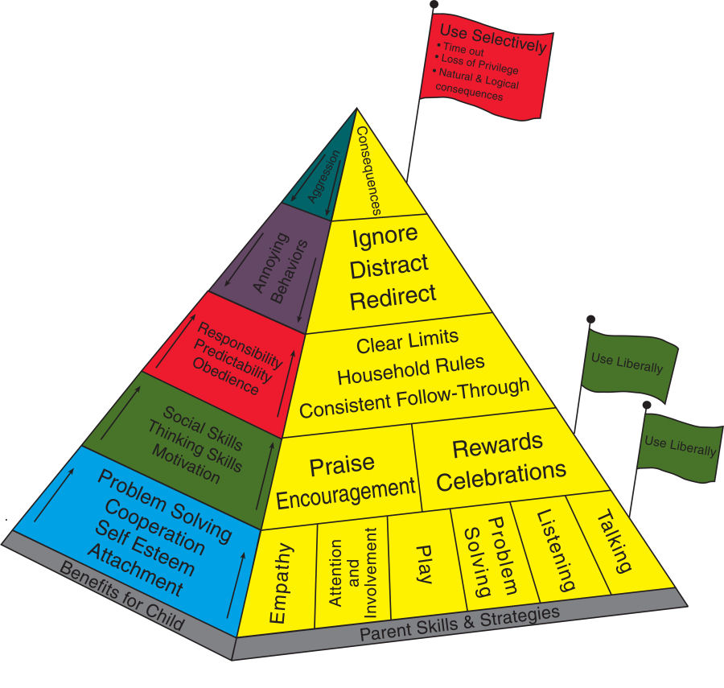
The Parenting Pyramid
Notes:
Brief overview of the pyramid
Hi-light first half of programme (6- ? Weeks) are spent developing and strengthening relationship / bond between parent and child. Evidence has shown that the strength and consistency in relationship reduces incidences of negative behaviour in child thus resulting in less need for harsh discipline. Most parents will see a difference in their child’s responses within first 4-6 weeks if they are practicing the guidance given.
Boundary setting and consequences are covered in final 6 – 12 or 15 Weeks of programme. (dependant on the length of the course being run).
One of the fundamental key aspects of this programme is the collaborative working of the group. The leaders are purely facilitators of the devised programme; the parents find the answers through working together and supporting each other. This means that the parents have got to want to be there and that they are willing to practice at home the principles given.

Slide 7
How do we measure Outcomes/impact?
Routine Outcome Measure’s (ROM’S):
SDQ – Parent version
Warwick Edinburgh Mental Wellbeing Scale
Parenting Scale
Notes:
Rom’s are completed pre and post course to identify the distance travelled for each attendees:
SDQ – is a brief emotional and behavioural screening questionnaire for use with 3 – 16 year olds. Parents complete this to identify how they view the behaviours for their child.
Warwick Edinburgh Mental Wellbeing – This monitors the mental well-being of the adult attending the course covering the feeling and functioning aspects of mental wellbeing.
Parenting Scale – this looks at how parents parent using 3 subscales that look at laxness (Inconsistent parenting), over reactivity (harsh or punitive parenting) and hostility (the extent a parent hits, curses or insults their child).

Slide 8
What parents say…..
“Amazing” “Life-changing”
“The violent strops have stopped”
“Life is so much better. We get on a lot better than we ever have.”
“I couldn’t go back to how I was.”
“I felt at ease all the time and relaxed (during the programme).”
Notes:
In South Derbyshire, parents who have already completed the programme say:
“Amazing”
“Life-changing”
“The violent strops have stopped”
“Life is so much better. We get on a lot better than we ever have.”
“I couldn’t go back to how I was.”
“I felt at ease all the time and relaxed (during the programme).”

Slide 9
Testimonial
Notes:
Handout on the tables/in your packs of the parent of an eight year old female who completed the Incredible Years course and her experience.

Slide 10
Moving Forward
How do we want to progress in the locality?
Secondary Schools
Voluntary Sector
Increase the number of facilitators
Notes:
So with this in mind how do we want to progress in the future?
Due to the success of co delivering with the local primary school we are keen to see this expand further with the 8 -13 years programme and replicate with Secondary Schools. This will allow a further increase in the number of 8 - 13 programmes we can offer over the locality meaning we can meet the need/demand in the area. There would also be the potential for programmes to be run at staggered intervals for example: a course could start in September with a further course starting 6 weeks later. The feasibility of this would have to be explored due to the impacts of school holidays and whether this would impact negatively on the retention rates of courses.
Working closer with colleagues in the voluntary sector. This will increase the number of experienced facilitators who can support sessions.
This will be something we develop within the LCP working group.

