Slide 1
0-5 Provision Ready for School
Julie Stanley
Bolsover/North East Derbyshire Children’s Centre Services

Slide 2
Introduction
Bolsover and North East Derbyshire has a significant higher percentage of children living in poverty
Our area has:-
9,185 Under 5’s
3,445 Under 2’s
71.7% of children have a GLD
571 may be eligible for 2 year funding
117 children and parents supported with ECAT
A high percentage of our children are not school ready
Notes:
NE-BOL is the largest district in Derbyshire and we have to recognise that this is a challenge to deliver effective services on a large-scale
Do we know what percentage of our children are not school ready? How do we identify this – statistics? Feedback from schools? Through local and national data and Local knowledge 71.7% of children had GLD locality wide but there are areas within the locality that are significantly lower. We also gather feedback form Cluster meeting, directly from school and our health Colleagues
Since 16 we have supported 117 children and parents in the ECAT programme (I have put this in the slide)

Slide 3
Why focus on school readiness?
County-wide focus on school readiness (Sue Ricketts)
LCP awareness of local needs
Strong District links between Early Help services and local schools and nurseries
Long-term benefit for children and families
Notes:
1. Sue has given her presentation on school readiness to a number of meetings, locally & countywide to raise awareness of this issue 2. Through LCP and sub-groups we are aware of the needs of children in the district and the scale of the challenge in NE-BOL
3. As we have established good working links between our Early Help services, our 0-5 team and local schools, pre-schools & nurseries we can work together to deliver effective support to children & families in NE-BOL
4. Evidence (e.g. as seen in Sue Rickett’s presentation) shows the importance of early support to children’s development and school readiness is a significant part of this We are looking at being school ready for reception as the ‘sensitive periods’ in early brain development is the highest at 0 to 2 years and the focus of work agreed for 16/17 was communication and Language, Toilet training

Slide 4
The LCP role and Partner involvement
Shared understanding of local challenges
Shared responsibility to support local needs
Recognition of services already on the ground
Willingness to work together and innovate
Partnership in public, private and voluntary sectors
Notes:
LCP is able to bring local agencies together to develop a comprehensive understanding of local needs
Multi-agency approach shares the responsibility to address the identified needs
LCP takes a practical approach – if we already have services that are working to address a need then we can build on that – no need to ‘reinvent the wheel’ every time
LCP is a forum that can reach consensus and provide a lead to local agencies to increase cooperation and also encourage fresh thinking where established approaches aren’t delivering
In this instance we had to recognise that pre-school children engage with a range of different services and we need to work across all these sectors to maximise the effectiveness of the support programmes

Slide 5
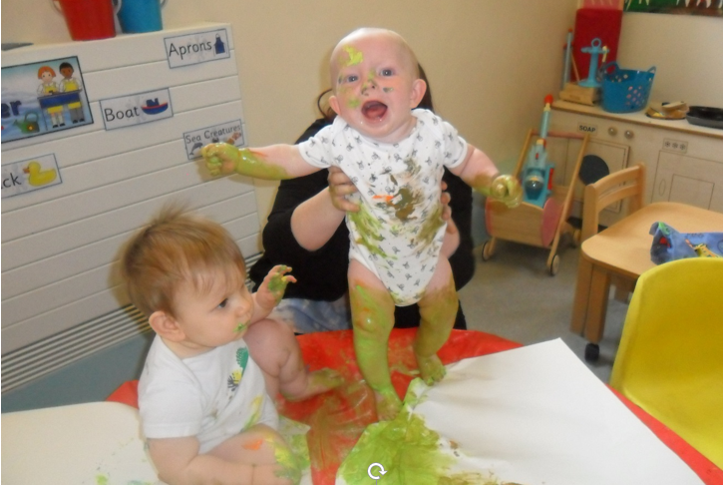
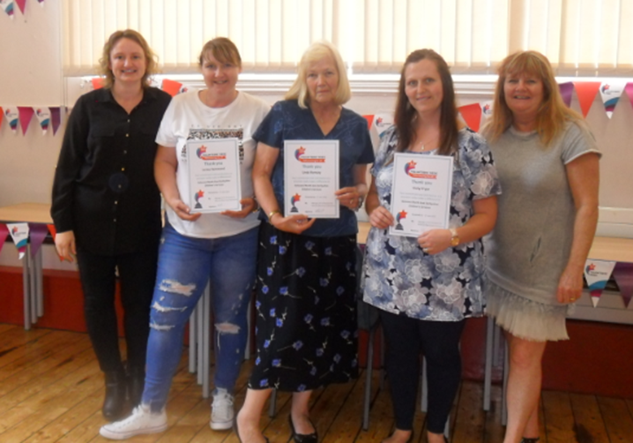
Our Groups and Sessions
Groups run by volunteers
16 active volunteers
8 training to work as Parent Champions
Thriving Communities
Volunteer Training
Targeted Groups
Notes:
0-5 staff help to recruit volunteers, mostly parents from within our communities, to run universal groups that enable some of our most vulnerable families to attend and engage. These groups focus on school readiness as do our targeted groups (rationale & handout?)
These trained parent champions go into schools & nurseries to promote 2-year funding
Volunteers benefit from in-house and vocational training and may go on to pursue a career in child-care

Slide 6
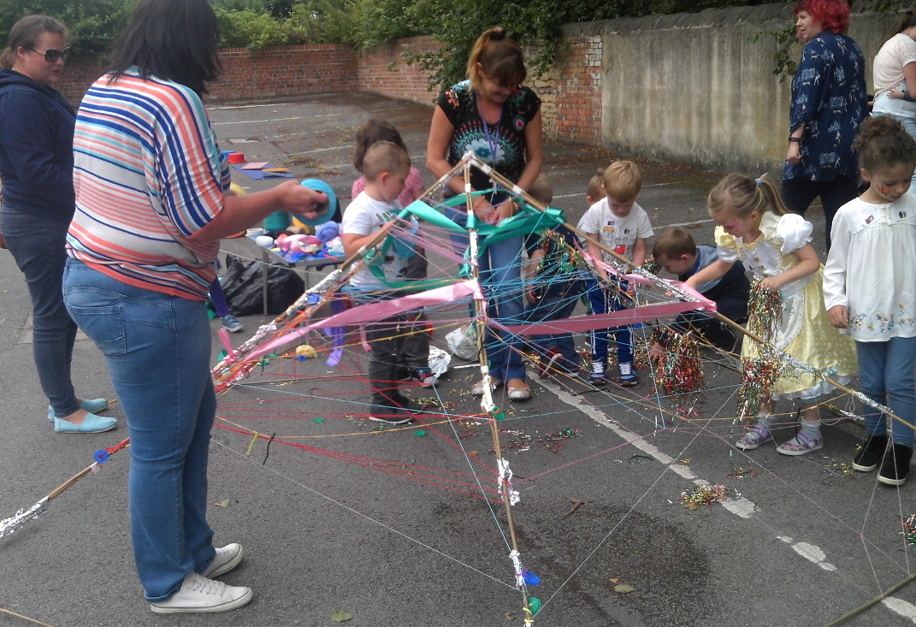
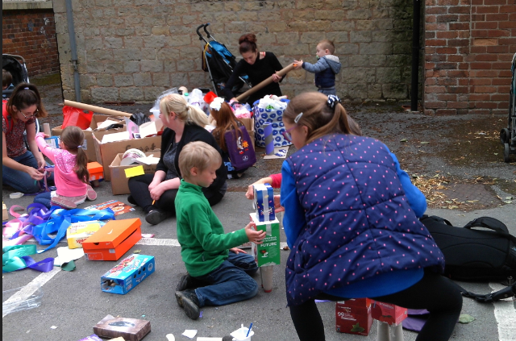
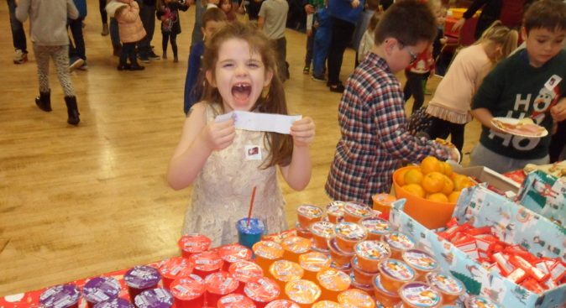
Roadshows
Why?
What?
Where?
Who?
Outcomes
Notes:
Why did we think roadshows were an effective method? Encourage community Cohesion, having an impact on social and emotional development. Raising parents aspirations. The services is able to reach a wider audience across the locality, Where there has been a need identified from our partners and or our own local knowledge
What did we include in the programme for these roadshows? Based around the social pedagogy approach encouraging parents to work and play with their children and others activities like den building , large box modelling, physical actives etc
Where did we target the roadshows and why? Local community Centres, Parks, which changes from term to term ensuring the majority of areas receive a service in particular those with a higher percentage of need. Some were delivered in term time after school the majority in the holidays
Who was involved in delivering the roadshows and who came along to them? EYFP, CEW, social workers, MAT teams, Youth workers, police and fire service, health professionals
What did they achieve? How do we know this and how are we going to build on it for the future? Summer 17 - 648 attended, families were made aware of the services the Children centre provided, their feedback on development of services, volunteers were actively recruited, This year we have increased the number of events o enable us to do this we use other professionals and volunteers more effectively

Slide 7
School Ready Sub-Group and Partners
Purpose is to bring together a group of professionals from schools, health, sufficiency team etc. to look at issues arising and the impact of our actions
Our work with Partners and how we are complementing services without duplicating
Developing local plans to meet the identified needs
Notes:
How many in the Sub-Group? Our sub group partners are schools(although she has not attended as yet but has been invited to all) Health, CEW, Early Years sufficiency officers, day care providers
How we are working with Health Visitors etc. We meet with all the HV on a termly basis either as a group or individual representative
How we will plan for the future and link those plans to wider district initiatives through LCP? My team meet on a regular basis where we look at the performance indicator locally and nationally, at district initiatives and develop a plan while being aware of the ever changing needs of families within our communities and being realistic with what we can provide to ensure a quality of service and how we can work with other professionals to achieve this.
Plan to develop Sub-Group with input and lead from Senior Team Manager

Slide 8
‘School Readiness’…
Workshops on:-
Toilet Training
Bin The Bottle
Ditch The Dummy
Speech Problems
Behaviour Management
Practical approaches for parents to
work with professionals to help their
children achieve the 10 keys
Notes:
How have we linked these specific workshops to meeting the 10 keys? Focus for School Ready in Derbyshire being communication and language and Toilet training also through request from schools
What sort of attendance/engagement have we had from parents? Positive although some numbers have been small as schools have targeted specific parents Engagement has been very positive
What sort of settings have we delivered these in? Schools and nurseries
How much more flexibility could we build in to achieve maximum impact from these? We already work flexibly to meet the needs of the school and parents at various times throughout the day

Slide 9
Outcomes
Progress so far
How can we measure this?
Short-term and long-term targets
Notes:
What have we achieved through the volunteer groups, roadshows and school readiness presentations?
How do we know what we’ve achieved so far? If we are not measuring this yet how could we ensure we measure it in future (either through data from schools or from direct feedback from course participants and schools/nurseries
What is the benefit to the children in the short term (ready for school, ready to learn, wider benefit to whole classes if less time spent on toilet-training etc.) and the long-term (greater chance of successful school achievements over time if the foundation is well-established
What is the benefit to schools (e.g. better able to use their resources on teaching and developing the children beyond the ‘school-ready’ stage)
What is the benefit to families overall (less nappies, improved communication between children & parents, better behaviour – less tension in families, less risk to children)

Slide 10
Next Steps
Identifying future needs
Linking to voluntary and private sector partners
Wider funding opportunities
Thriving Communities projects
Continued feedback, analysis and adaptation
Notes:
We need to be sure that we know what needs we will be addressing in future to enable proper planning for this as we recognise our resources are limited
The nature of child-care and pre-school provision means that we need to work together across our own sector but also with private nurseries and voluntary groups in our communities
Many of our partner agencies (e.g. schools) and our own Community Engagement Workers will have knowledge of and access to other funding opportunities. We need to be prepared to take advantage of these options to improve the level of resources available across the board to support the needs of children in our district
NE-BOL has 2 Thriving Communities projects in progress (Danesmoor & Shirebrook) and we need to link into their local knowledge and connections to ensure we are able to achieve the maximum impact from these programmes
We will continue to draw back information from these programmes and groups to understand the impact and outcomes for our children and be prepared to adapt and innovate to ensure we are supporting the best possible outcome of the maximum number of school-ready children in NE-BOL

