Slide 1
Fiona Cowan
Headteacher
Bolsover Infant and Nursery School

Slide 2
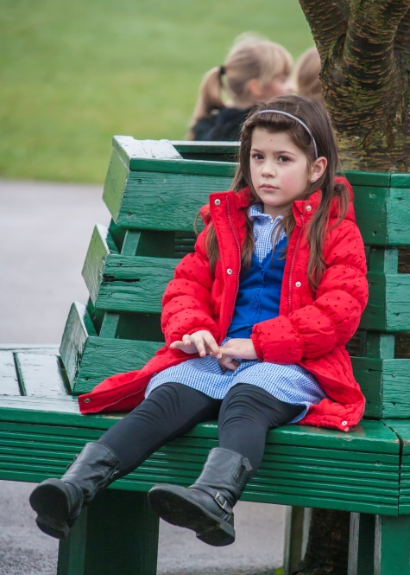
Positive Locality Partnership Working - an Education Perspective
The journey so far…

Slide 3
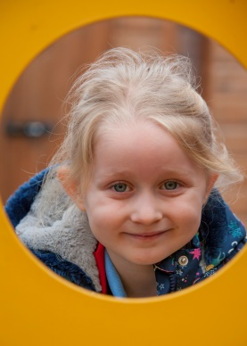
Early Help Offer
They saying ‘it takes a village to raise a child’ this always makes me think of Early Help
Positive impact on children’s lives, working with parents to help make a difference. (Seen this first hand from early ‘Family Resource Workers’ based in schools to MAT and Joint commissioning)
So when an opportunity came about to ‘Radically Re-think the Early Help Offer’ - and to work jointly with other professionals, to undertake joint commissioning to impact positively on our vulnerable families before they get to crisis - we were eager to get involved.

Slide 4
Non-negotiable for me and our team…
When I became a teacher I made a commitment to the children, parents and staff that I would always prioritise the children, their families and the needs of the community. Started at Poolsbrook and developed at Bolsover.
Support parents before they were in crisis – trying to be pro-active and not just re-active
Offering whatever support was on hand, to help improve children’s lives.
This work was enhanced by the first Family Resource Workers, situated in our schools, to the development of Multi Agency Teams. We have always tried to work collaboratively and effectively as possible for children and families.
Plus I have a big mouth and am quite opinionated!

Slide 5
Who is ‘we’?
Bolsover Excellence Schools Trust
Schools Involved:
Bramley Vale Primary
Brockley Primary
Arkwright Primary
Duckmanton Primary
New Bolsover Primary
Bolsover C of E Juniors
Bolsover Infant and Nursery
Palterton Primary
Scarcliffe Primary
Sharley Park Primary
Tupton Primary
The Bolsover School
VISION
Inspiring all, to learn and achieve their best, in our schools and communities.
AIM
We aim for all of our schools to retain their autonomy and the individuality which makes each one distinctive and unique. However, collaborative working will make them stronger. Together they will take a collective responsibility to provide support and challenge on the path to excellence for all.
Bolsover Excellence Schools Trust values:
At BEST we value children and ensure they are key to all of the work we undertake.
We value:
The diversity each school brings to the collaboration
The well-being of all to enable enjoyable and effective learning
Sharing expertise, experiences and opportunities across the range of schools with all stakeholders
Open and honest relationships based on mutual trust
A cohesive and strategic approach to education that benefits the whole community equally
The pro-active commitment of all to achieve the vision
Collaboration
Collective Responsibility
Support
Challenge

Slide 6
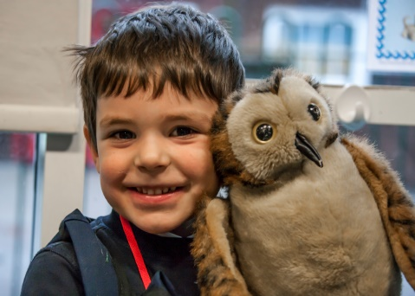
Understanding the plan…
Derbyshire County Council
Derbyshire Safeguarding Board
Derbyshire
Childrens Trust
Childrens Locality Partnership
Bolsover, Shirebrook, Clowne Early Help Cluster
Clay Cross, Tibshelf, South Normanton Early Help Cluster
Eckington, Dronfield Early Help Cluster
6 MAT Teams; 5 Social Care Teams; Schools, Other Partnerships

Slide 7
A seat around the table
North East and Bolsover District Locality Partnership
Some services we had worked with before, but most services were new to us.
We were eager to share our work and find out about the work of new services
Shared agenda for improving services for families
There are lots of people who attend and there is always someone new at the table.

Slide 8
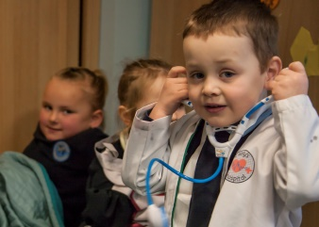
Ambitious start…
Our ambition was to ensure that children within our Locality:
Have the best possible start to life.
Are ready for school and able to learn.
Have aspiration and are able to reach their potential.
Are protected from harm.
Grow up in households free from domestic violence, neglect or abuse.
Are emotionally resilient and have access to early support where there is evidence of emerging mental health needs.
Develop healthy relationships
Topics covered:
Domestic Violence
CSE and Cyber Crime
Early Help
Emotional Well being
School Readiness
NEET/Workless Families

Slide 9
Bolsover Infant and Nursery School Where little people learn to dream big!
The impact of the Locality Partnership in our school:
Two rounds of Incredible Years
Support for Mumming and Dadding About
Safeguarding Newsletter
Better links with locality services and local schools outside of the cluster
Time to focus on the ‘Early Help’ agenda
MAT links
Mental Health audit – links with the secondary school
Understanding of the data – Mental health support, Exclusions, Home school, House fires etc
Understanding around ‘Troubled Families’ agenda
Training – CAMH’s Specialist Community Advisor
Graded Care Profile – MAT and Social Care
School readiness work – 2 year old assessments
Mental Health and Well-Being Focus

Slide 10
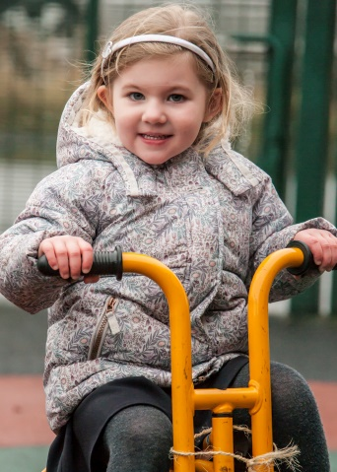
Joint Commissioning…
Through focused locality ACTION PLANS we have managed to identify the priority needs in our area
Through COLLABORATION we have been able to undertake more focused and richer joint working to address these needs
Through JOINT COMMISSIONING we have been able to begin filling in the gaps
Everyone is eager and willing to work with Education – Joint commissioning on a shared agenda.
It seems to be us in Education who is finding it hard to comprehend.

Slide 11
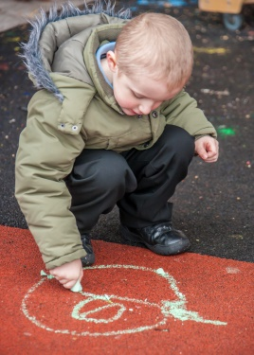
Navigating the Landscape…
Schools need to commit to the process
Other services are there and eager to work with our young people and families
Joint Commissioning is the way forward
What would I like to see…
Every school across the County with a ‘Parent Plan’
All schools, inc Secondary Schools and 0-5 setting committed to Early Help and Joint Commissioning – not just looking at case worker and Family Resource Workers

Slide 12
When we get in right! Case Study…
Family History
Laura had a history of Sexual Abuse
Multiple Partners
Postnatal Depression
Infant Death – 1st child
Domestic Violence
Alcoholism
Child abandonment x Matty (12) and Mark (9)
Homelessness
Mental Health issues
Laura lived Zander (6) with Jack - Dad of Alfie (4) and her new partner Bob
Services already involved before Zander started school:
Private day care for 1 year (only accessed 3 year old funding)
Alfie signed up for 2 year old funding and to transfer to school
nursery in January
Mark living with his Step Mum as Dad had gone into Re-hab (three times)
Social Care
MAT/Children’s Centre Worker
Health
School met in Summer term
Pro-Active Relationship from the start:
Pastoral Care team / Headteacher
School Health
Behaviour Support
SEN
Incredible Years - Friendship
Dadding About / Mumming About – Adult Care intergenerational work / Public Health / Adult education
HENRY
Adult Ed
Adult Mental Health work
Bolsover Church of England
Relationship now:
Zander is in school 2- Making progress, attendance good
Alfie accessed 2 year old funding, in school nursery now and moving to Reception – Progress positive
Mark back with Mum and doing well with Juniors
Laura and Bob in their own home
DBS/Trips/Return to work for Bob/School Readiness
Open and honest relationship
Mental Health support for Laura
New friendships to support all
Partnership working Proactively has really supported this family in becoming a success.

Slide 13
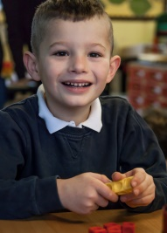
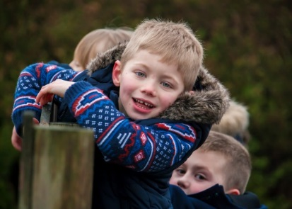
The Landscape Ahead
Needs to be truly joint working
Schools need to commit to working with parents
Parent Plans for every school with all staff committed to a parent plan
Parenting - Helping with parenting and childrearing skills and setting home conditions to support a child’s abilities to access school.
Communicating - Communicating about school, attainment, achievement and child’s progress
Participation - Supporting school and school programmes. Improving involvement in school activities, inc audiences at school events, PFA etc
Learning at home - Learning at home, homework and curricular based activity.
Decision Making - Participating in decision making, school governance, questionnaires, information sharing about the school to benefit the school, children, other parents and stakeholders and the community
Collaborating with the community - Services for parents in the community, liaison with the school and outside agencies.
School committed to the Locality Partnership way of working and attending Early Help meetings
Dadding about and Mumming about in every school!

