Slide 1
Sophie’s Family Story
Tim Roberts- Participation Childrens Rights Officer Adele Glover- Locality Manager, Amber Valley

Slide 2
Introduction
I would like to introduce to you a family I have worked with closely for a number of years:
Mum - Evette
Sophie (17)
Jack (14)
Megan (9)
Alex (4)
This family has been supported by different services.
They would like to share some of their experiences in order to help us better understand the impact of our work and how we can improve.

Slide 3
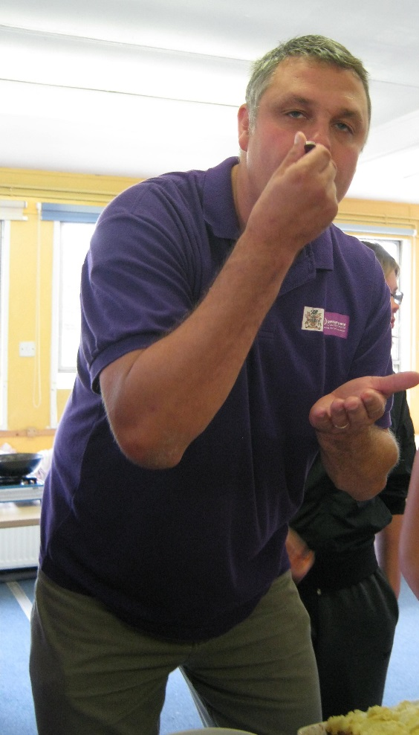
Ready Steady Cook 2012
Tim Roberts – Youth worker (age unknown)
(Better than Gregg Wallace at tasting food)
Sophie - a budding chef
(age 11)

Slide 4
Services Timeline
Mobile/targeted youth work and School transition work. (2012)
Children’s centre services (2013)
Keeping it real (CSE risk reduction group) (2014)
Health visitor (2017)
MAT family resource worker (2016)

Slide 5
Summary SUF -Youth Worker
The Youth Worker role was explained several times clearly
I felt listened to and involved in the planning of services
I have contact numbers for my Youth Worker
The support that I have received has had a positive impact on; my life now, my college/school and feeling safe
“My worker was good at ensuring I was coping and offered as much support as possible”
“I can rely on my worker to help me to make positive changes”
I would rate the overall services that I have received as excellent

Slide 6
Summary SUF - Childrens Centre
“Worker explained their role clearly and explained really well why the team at the Children's Centre have to ask the questions they do”
Worker started Alex with support for speech and language:
“Worker had some experience with speech and language and could explain how she thought that this language delay was different.”
Evette could easily get in touch with her worker:
“The things that I thought that my worker did that was good were the groups I was directed to and to start the EHCP process.”
Could the worker have done anything better?
“The information on the range of services available to family on first contact was limited. I only found out what was available as I went along it would have been better to know from the start. This would then have enabled more support to happen more quickly.”
Overall rating of experience of service is excellent.

Slide 7
Summary of SUF- MAT Family Resource Worker
The worker explained their role clearly. I felt listened to and involved in the planning of services and support available to me:
“This was a very traumatic time for me but support was always at the end of the phone.”
My worker understood my thoughts and feelings and what was most important to me: “My worker was concerned for my mental health and well being and supported me through this.”
“My worker was good at linking support for all of the family i.e. family days youth activities. She even did a tip run with me and helped me to move house. If it hadn’t have been for the support of family resource worker I wouldn’t have been able to cope.”
Could your worker have done anything better ?
“Corinna was the best person for the job”
Because I had to move from Belper into a different MAT locality area, continued support had to come from a different team. My support needs are different now. But I think it is important that if you get to know someone and you trust them this makes things easier and you are not starting again.

Slide 8
Summary of SUF - Health Visitor
I didn't feel involved in the planning of services or listened to: “I felt that I needed a specialist support worker for autism, but this wasn’t available.”
The worker didn’t understand my thoughts and feelings and what was most important to me: “I felt that the health visitor didn’t fully understand Alex's needs. She didn’t listen to me when I tried to explain this. She tried to get me to do things that Alex wasn’t ready for.”
Could the worker have done anything differently/better?
“Yes, be more understanding.”
I would rate the overall services as satisfactory.
“I am now in support of more appropriate services that meet Alex's needs.”

Slide 9
Actions from Service User Feedback Forms
You said | We did | Outcome
It was hard to start again in another MAT area with a new team. | Review in locality handover process- no longer automatic. Transition period established to be 8 weeks. | Better consistency and less disruption for families. Reduction in the number of times families have to tell their story. Fewer re-referrals.
Some staff had lack of understanding around needs of Autistic children. | Autism training program delivered across partnership in Amber Valley. | Staff more able to advise and support appropriately.
Local partners knowing what service provisions are available to support families | Patch based partnership workshops to share information on services and better understand role and responsibility | Staff more able to signpost families to suitable services and are better able to refer families to services that are suitable to need identified

Slide 10
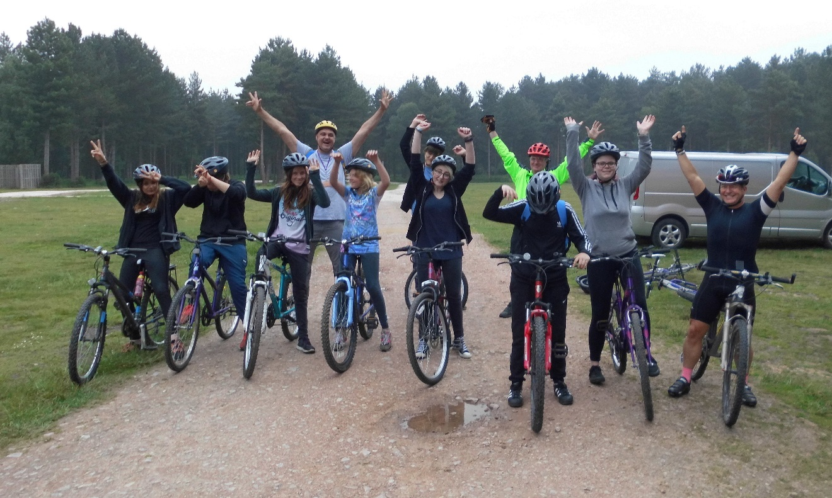
Titans Trust/Participation team/Amber Valley MAT Locality Team Sherwood Pines Bike Ride

Slide 11
Amber Valley Locality Children’s Partnership
Service User feedback – ‘You said, We did’ strategy
Our family have advised us of areas of improvement that we can work on within our partnership, specifically in respect of skill set for ASD conditions
Communication across partners impacts directly on the experience of the service user (speed and suitability of response)
Importance of knowing local services and signposting
Youth voice embedded from the youth forum
‘Say No to a Straw’

